Slide 1

C++ Programming
Michael Griffiths
Corporate Information and Computing Services
The University of Sheffield
Email m.griffiths@sheffield.ac.uk

Slide 2
Introduction
C++, Developed by Bjarne and Stroustrop
Commercially released 1985
Extension of C
  C is a subset of C++
Language improvements
Provides Object Oriented Programming Capabilities
ANSI C++ Standard published 1998

Slide 3
C++ As “Better” C
More robust
  Stronger type checking
Hides complexity
Enables user-extensible language

Slide 4
Standards for C and C++
International Standard for the C programming language is ISO/IEC 9899:1999.
The current American National (ANSI) standard is ANSI/ISO/IEC 9899:1995
International Standard for the C++ programming language is ANSI/ISO/IEC 14882:1998 which first became a standard in 1998.

Slide 5
C++ ANSI Standard
Standard library
Standard Template library
  Wide range of collection classes
Exception handling
Namespaces

Slide 6
Standard Library
Header file names no longer maintain the .h extension typical of the C language and of pre-standard C++ compilers
Header files that come from the C language now have to be preceded by a c character in order to distinguish them from the new C++ exclusive header files that have the same name. For example stdio.h becomes cstdio
All classes and functions defined in standard libraries are under the std namespace instead of being global.

Slide 7
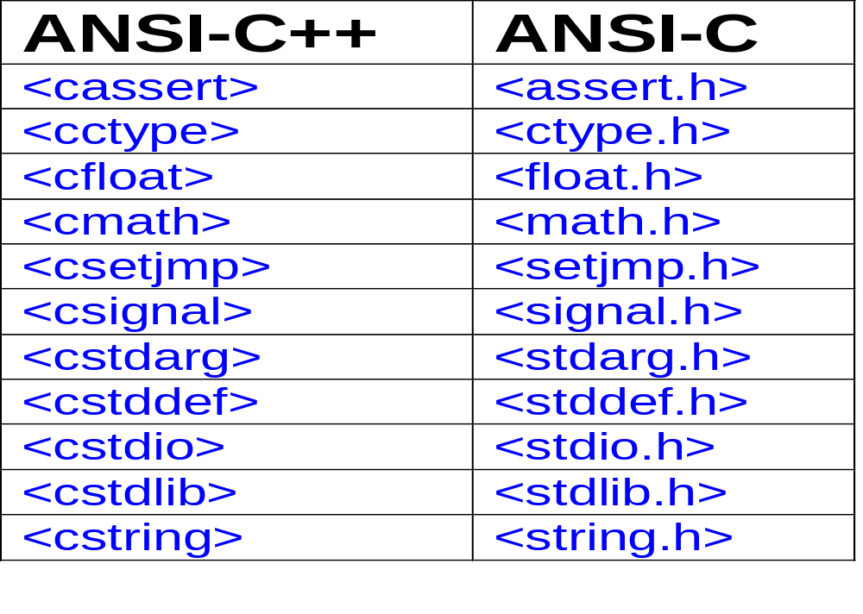
ANSI C Libraries and ANSI C++ Equivalents

Slide 8
Features
Comments
Stream input and output
Constants
  The const keyword
Declarations as statements
Inline expansion
References

Slide 9
More Features
Dynamic memory allocation (new and delete)
Function and operator overloading
User defined types
Data abstraction and encapsulation
  Use classes to incorporate new types
Scoping and the Scope Resolution Operator
Template

Slide 10
Comments
Traditional C comment (can be used in C++)
  /*This is a traditional C comment*/
C++ Easier comment mechanism
  //This is a C++ comment

Slide 11
Stream Input and Output
C++ Provides operators for input and output of standard data types and strings
  Stream insertion operator <<
    Alternative to printf
  Stream extraction operator >>
    Alternative to scanf
To use C++ stream operators include the header iostream

Slide 12
Stream Input and Output Examples
cout<< “Hello World\n”;
  Displays Hello World
  Note use of the escape characters used in C
cin>>a>>b;
  Assigns data read from the input stream to the variables a and b
Can still use printf and scanf but it is not good to mix usage of these with stream operators

Slide 13
Reading Files Using ifstream
#include <iostream>
#include <fstream>
using namespace std;
int main ()
{
  ifstream infile;
  infile.open ("test.txt", ifstream::in);
  while (infile.good()) cout << (char) infile.get();
  infile.close();
  return 0;
}

Slide 14
Using ofstream to Write To Files
// ofstream::open
#include <fstream>
using namespace std;
int main ()
{
  ofstream outfile;
  outfile.open ("test.txt", ofstream::out | ofstream::app); outfile << "This sentence is appended to the file content\n";
  outfile.close();
  return 0;
}

Slide 15
The const keyword
In C constants normally defined using
  #define PI 3.14159265358979323846
In C++ use the const keyword
  Declare any variable as const
  const double PI = 3.14159265358979323846;
A const object may be initialized, but its value may never change.

Slide 16
Advantages of Using const
Allows the compiler to ensure that constant data is not modified generate more efficient code
Allows type checking

Slide 17
Combining const with pointers
Read only pointer
int i = 10;
const int *pi = &i;
*pi = 15;// Not allowed! pi is a const pointer!
Cast away const
  *((int*) pi) = 15;

Slide 18
Declarations as Statements
In C++ a declaration can appear wherever a statement appears
Declarations are closer to where variables are used
  Code more legible
  Only make declarations when necessary
E.g. Declaration in a while loop
while (ptr && !found)
{
int item = ptr->data; // Declaration
….. Statements….
}

Slide 19
The inline keyword
#define key word define macros
  Avoids overhead for calling small functions e.g.
  #define max(x,y)((x)>(y)?(x):(y))
C++ provides inline keyword e.g.
  inline int max(int x, int y){return(x>y?x:y);}
  Although use of inline statements may improve performance. It will increase the size of the compiled object files

Slide 20
Reference Parameters
C++ Provides true call by reference through the use of reference types
  Reference is an alias or name to an existing object
  Similar to pointers
  Must be initialised before use

Slide 21
Declaring a reference
Declare an integer
  int n=10;
Declare the reference
  int &r=n;
Assignment n=20 changes both r and n to 20
Assignment r=-10 changes both n and r to -10

Slide 22
Example of Using C++ References
Call by reference swap function in C
  void swap(int *a, int *b)
  Called using swap(&x, &y)
  Sometimes forget & in the function call….. Problems…
Swap function using references in C++
  void swap(int &a, int &b)
  Called using swap(x, y)
  Compiler ensures parameters passed by reference

Slide 23
Dynamic memory allocation using new and delete
In C sizeof(), malloc(), calloc() and free() are use
C++ provides new and delete
  new
    Allocates memory
  delete
    Frees memory
All memory allocated using new should be released using delete
Makes it easy to create instances of C++ classes (see later)

Slide 24
new/delete
C++ compiler maintains information about size and number of objects contained in arrays
Warning never attempt to delete pointers that have not been initialised with new
new and delete can be overridden
  Customise for particular classes
  Improve memory management

Slide 25
Using new
Allocating an integer
  int *pi;
  pi = new int;
  *pi = 1;
Allocating an array
  int *array = new int [10];
  for (int i=0;i < 10; i++)
  array[i] = i;

Slide 26
Using delete
Deleting the integer pointer
  delete pc;
Deleting the integer array
  delete [] array;

Slide 27
Function Overloading
C++ provides capability to overload functions and operators
With overloading the same function or operator can be given several different definitions
Used to provide different definitions for members of a class
Can be used for functions that are not class members

Slide 28
Overloaded search function
Implementations for searching arrays of int, floats or doubles
Compiler ensures correct function is called based on the types of arguments passed to the function.
int Search ( const int* data, const int key);
int Search ( const float* data, const float key);
int Search ( const double* data, const double key);

Slide 29
Overloaded square function
int square(int ival){return(ival*ival);}
double square(double dval){return(dval*dval);}
main()
{
cout << "The square of int 3 is "
<< square(3) << endl << endl;
cout << "The square of double 3.1 is "
<< square(3.1) << endl << endl;
return 0;
}

Slide 30
Recommendation
Do not mix C and C++ Programming Styles
  External c libraries can still be called
For C++ programs use the ANSI C++ header nad not the ANSI C headers standard libraries
Keep things simple
  Build Create new classes when necessary
  Take care when using inheritance
Avoid re-inveting the wheel, use SDK’s
  See the code repository references below

Slide 31
Conclusion
Advantages
  Powerful development language for HPC applications
  Portable
  Reusable
  Requires careful design
  Wide range of libraries enabling high performance and rapid development.
Disadvantage
  Very easy to develop sloppy and inefficient code!!!!!!!!

Slide 32
References
http://www.cplusplus.com
Standard template libraries
  http://www.sgi.com/tech/stl/table_of_contents.html
Bjarn Stroustrups homepage
  http://www.research.att.com/~bs/homepage.html
Documentation for Sun Compilers
  http://developers.sun.com/prodtech/cc/compilers_index.html

Slide 33
Code Respositories
http://sourceforge.net/
http://www.netlib.org/
http://freshmeat.net/
http://archive.devx.com/sourcebank/
http://www.boost.org/
http://www.oonumerics.org/oon/

